Slide 1




Introduction to Mendelian randomisation
Gibran Hemani

Slide 2
Outline
Session 1:
Context, basic principles and assumptions of MR
How to perform and interpret MR analyses
What can go wrong
Sensitivity analyses
Session 2:
Practical

Slide 3
Causality
Modification of X will lead to Y
X is in the past and Y is in the future
X might not be modifiable
X might be one of many factors influencing Y
The state of Y might be probabilistic – X only influences risk
X might be causal but with a small effect
Counterfactual
If we had two universes in which everything was identical except the state of X, how would Y differ?

Slide 4
Background
Study designs in epidemiology

Slide 6
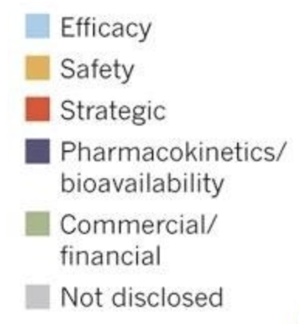
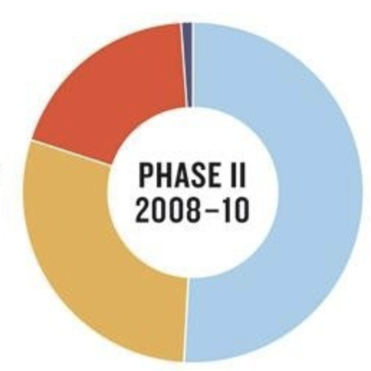
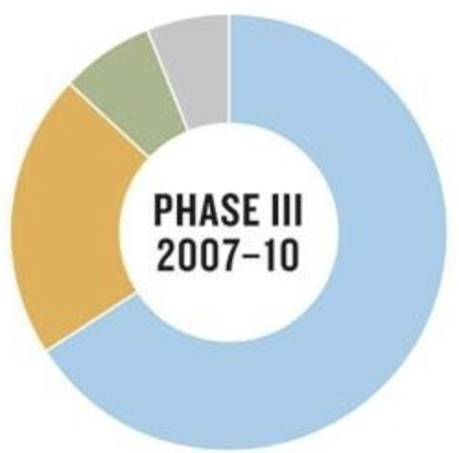
Vast majority of pharmaceutical compounds fail clinical studies…
…due to the drug target not having the expected outcome

Slide 7
What data do we have?
Many different study designs, but we will focus on observational studies
“Observational” data – sampling from a population
What are the methods for and limitations of making causal inference from observational data?

Slide 8
Linear regression
Slope is the association of X with Y
What can give rise to this slope?
- X causing Y
- Y causing X
- A confounder influencing X and Y
Similarly – if we try to estimate influence of X on risk of some binary outcome There could be a confounder
- Some variable associates with X, and is differential between cases and controls
y
x

Slide 9
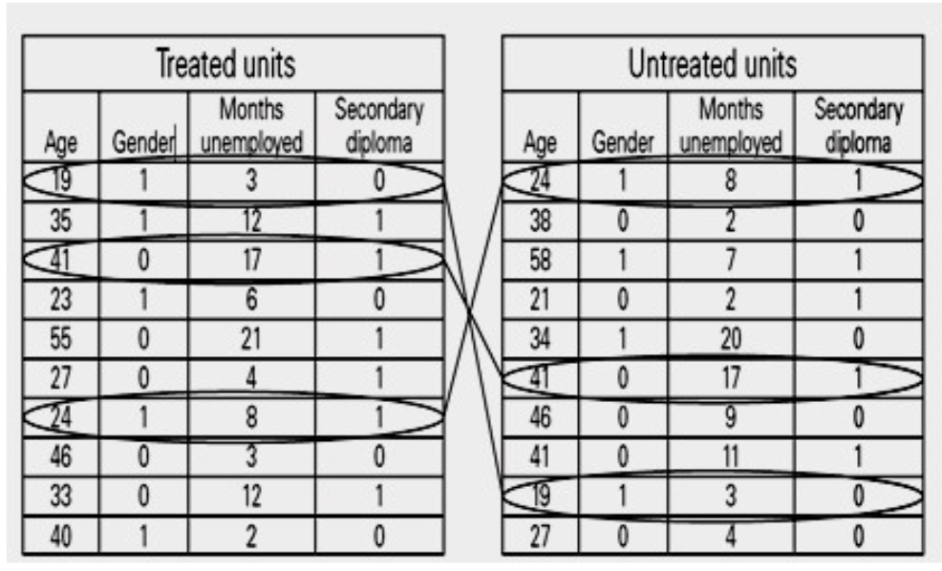
Matched controls
1. Start with observational data
2. Only compare cases and controls using a subset of samples
The measured characteristics between cases and controls are the same
The only thing that is allowed to vary (i.e. not matched) is the hypothesized explanatory variable (X)
This is analogous to adjusting for covariates in logistic regression
Problem: there might be unknown or imperfectly measured confounding

Slide 10
Randomised control trials
Experimental design (not observational)
Recruit samples
Randomly assign an intervention (X) to half
Provide placebo to the other half
The only difference between the groups is whether or not they had the intervention (X)
If the outcome (Y) is different between groups then this must be due to the intervention
Approximating the counterfactual framework

Slide 11
Problems with RCT
Very expensive
Not every intervention is ethical
Not every intervention is practicable
Could require very long follow up time
Can we better approximate the counterfactual framework using observational data?

Slide 12
Intro to Mendelian randomization

Slide 13
Instrumental variables (IVs)
Statistical method from econometrics
An instrumental variable (Z) is one that:
Associates with the exposure
Does not associate with confounders
Only influences the outcome through the exposure (exclusion restriction principle)
C
Z
X
Y
Exclusion restriction
Z is not independent of X
Z is independent of C
Z is independent of Y, given X & C

Slide 14
Why are genetic associations special?
Due to Mendel’s laws
Law of segregation: inheritance of an allele is random and independent of environment etc
Law of independent assortment: genes for different traits segregate independently (assuming not in LD)
The direction of causality is known – always from SNP to trait
Genetic variants are potentially very good instrumental variables
Using genetic variants as IVs is a special case of IV analysis, known as Mendelian randomization

Slide 15
Mendelian randomization analogous to RCTs
Randomized controlled trial
Mendelian randomization
Randomization method
Random segregation of alleles
Exposed: intervention
Control:
no intervention
Exposed: functional alleles
Control:
null alleles
Confounders equal between groups
Confounders equal between groups
Outcomes compared between groups
Outcomes compared between groups

Slide 16
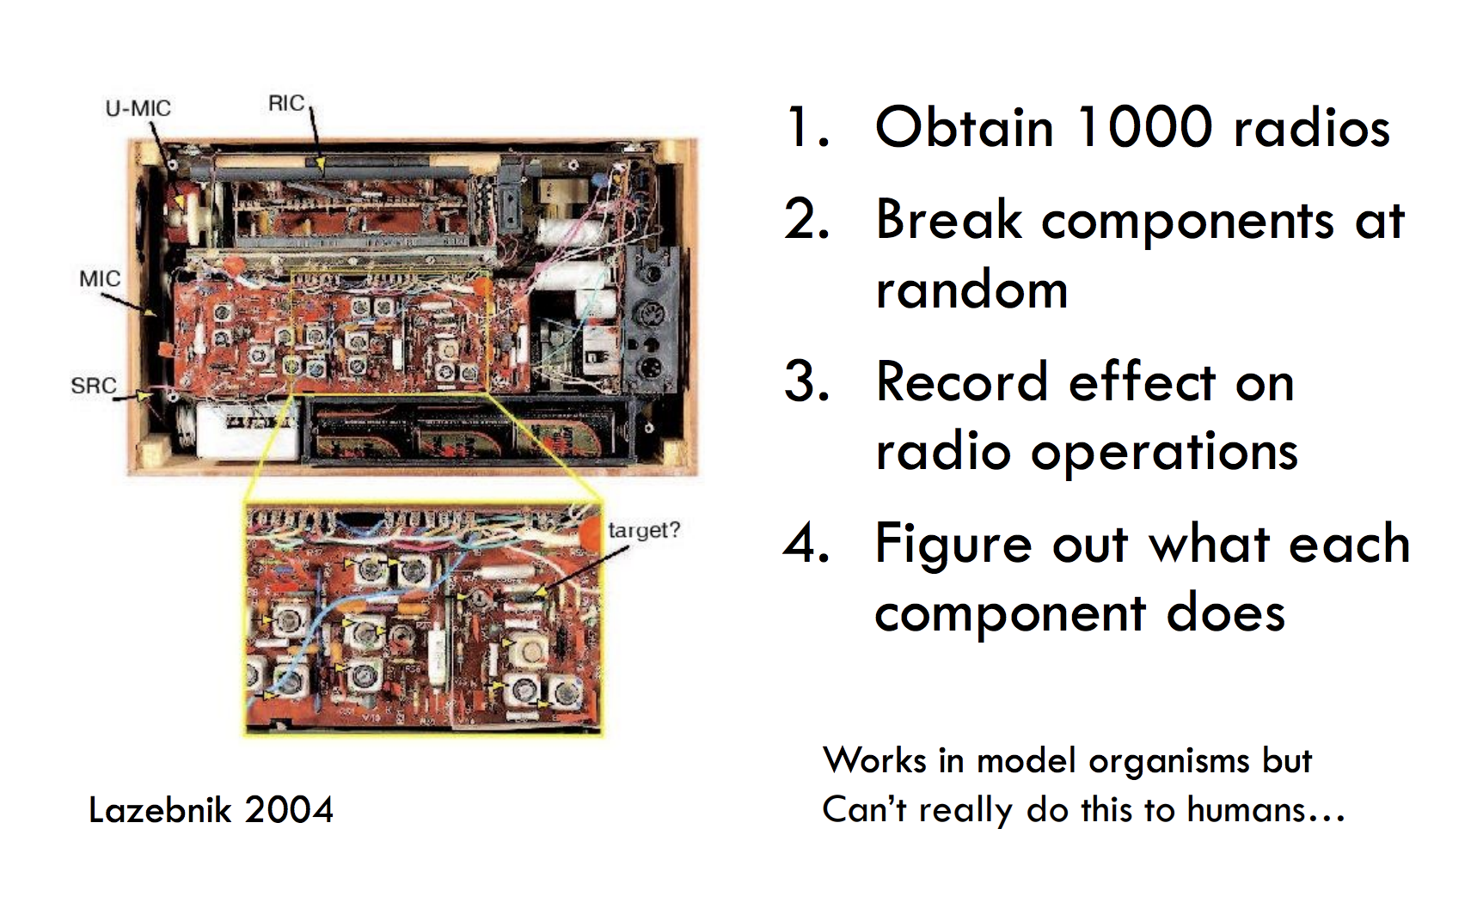
Can a biologist fix a radio?

Slide 17
A natural experiment…

Slide 18
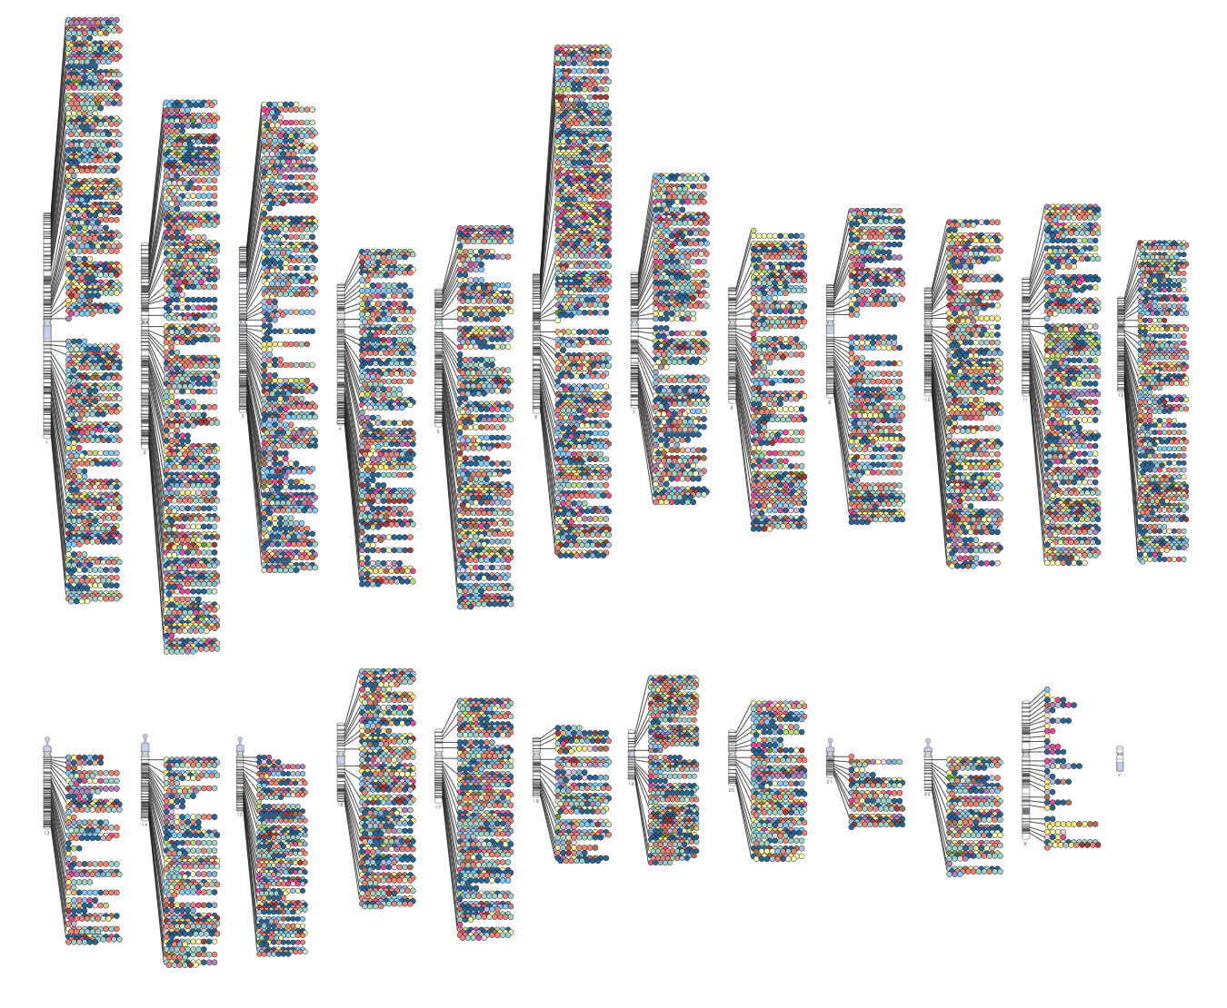

Slide 19
How to use genetic associations to infer causality
If X causes Y then everything that causes X should also associate with Y
Given we have sufficient power
If Z is a valid instrument for X then if it associates with Y then X causes Y.

Slide 20
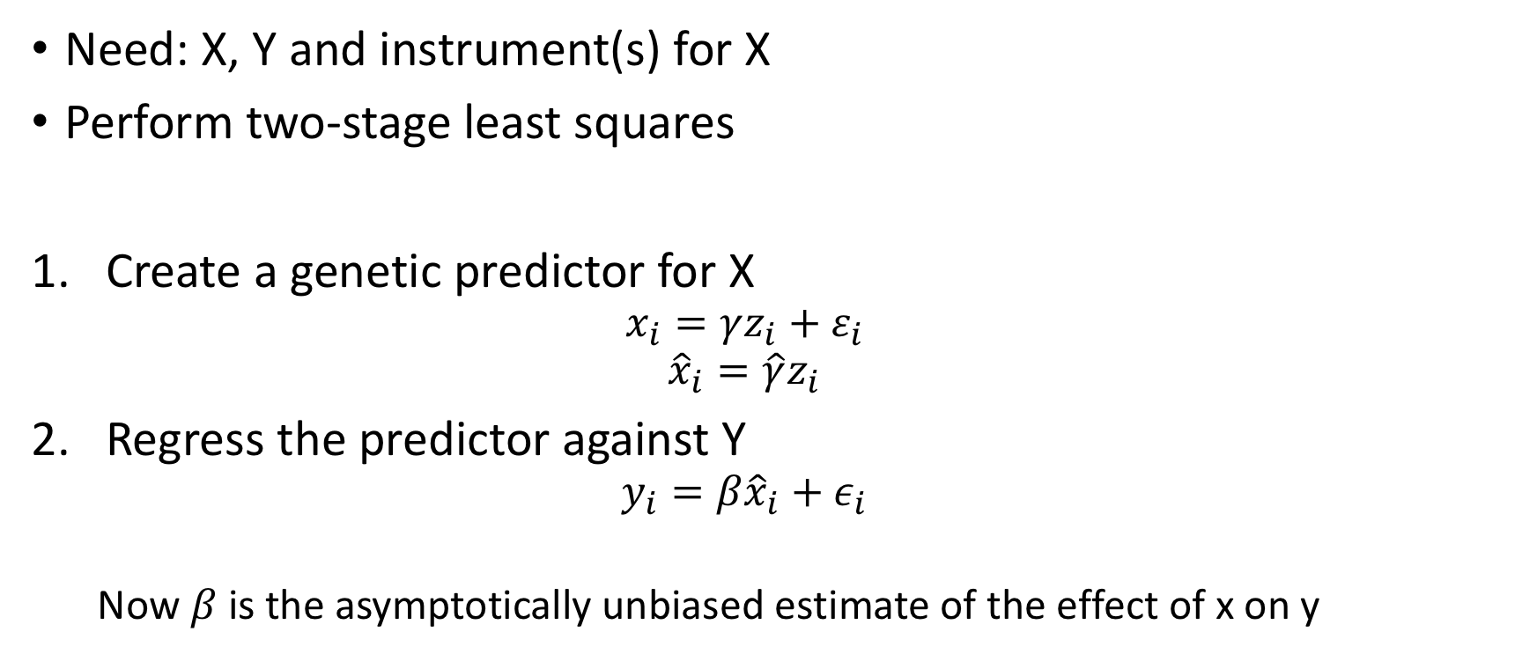
Mendelian randomisation using individual level data
Need: X, Y and instrument(s) for X
Perform two-stage least squares
Create a genetic predictor for X
$$x_{i}=γz_{i}+ε_{i}$$
$${\hat{x}}_{i}=\hat{γ}z_{i}$$
Regress the predictor against Y
$$y_{i}=β{\hat{x}}_{i}+ε_{i}$$
Now $β$ is the asymptotically unbiased estimate of the effect of x on y

Slide 21
Example: genes, CRP and CHD (risk factors)
C
Confounders
Z
CRP haplotypes
X
CRP
Y
CHD
Timpson N, et al. Lancet 2005

Slide 22
Observational association
Notes:
Trig plasma CRP both logged as highly skewed.
Obs assoc could be due to confounding, reverse causality. Or attenuated by measurement error / fluctuation in CRP levels.

Slide 23
… by genotype
Notes:
Not very clear! But rules out large overall effects or large effects of certain haps at e.g. high CRP levels.
Try plotting means for each diplotype:

Slide 24
Genotype means
Notes:
Still not very clear! Need to enlarge…

Slide 25
Zoom in…
Notes:
×10 (approx)
Squares sized proportional to number with that diplotype.

Slide 26
Add weighted regression line
Notes:
HIDDEN SLIDE
This is equivalent to IV
BUT the p-value/CI/SE of the slope from ordinary weighted regression is NOT valid:

Slide 27
+ standard errors of means+ fitted line
Notes:
Position of line can be got simply from weighted least squares.
BUT valid p-value/CI/SE needs IV methods to account for uncertainty in CRP.
[Several different IV methods are available (2SLS, GMM, LIML), won’t go into here. IV is overloaded with jargon…]

Slide 28
+ CI for fitted line
Notes:
CI is broad – MR gives large uncertainty compared to observational estimate.

Slide 29
Zoom out and put it all together!
Notes:
This gets messy. Graph reminds me of particle physics! ‘Observational’ line is (just) outside 95% CI from IV. In fact p-value for a test of whether they differ is 0.03. IV methods give us a valid test that allows for uncertainty in both ests and fact that based on same data so not indept.
HOWEVER:
If we use IV line to predict trig levels for the range of CRP in the population we are extrapolating way beyond the diplotype means to which the line is fitted.
This means there is a strong assumption that the effect is linear over this range.
(note this is stronger than the assumption of linearity in fitting blue line to observational data as that didn’t involve extrapolation).

Slide 30
Comparison of IV and OLS results
Ratio of values with doubling of CRP:
Comparison (test for endogeneity): P = 0.031
Linear regression | 1.08 (1.07, 1.09)
Instrumental variables | 0.99 (0.92, 1.08)

Slide 31
MR can also be performed using just the results from GWAS
Also known as two-sample MR, SMR, or MR with summary data etc
Advantages:
The data is readily available, non-disclosive, free, open source
The exposure and outcome might not be measured in the same sample
The sample size of the outcome variable, key to statistical power, is not limited by requiring overlapping measures of the exposure
Disadvantages:
Some extensions of MR not possible, e.g. non-linear MR, use of GxE for negative controls, various sensitivity analyses

Slide 32
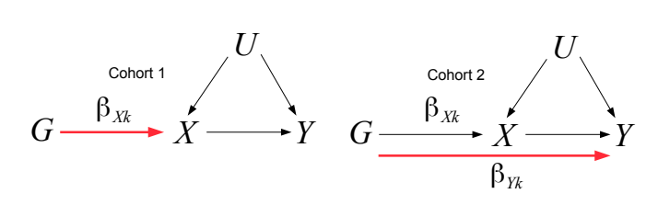
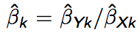
Mendelian randomisation using summary data
If there are multiple SNPs, obtain overall causal estimate by meta analysing the Wald ratios from each SNP.
Each SNP is used like an independent trial
Causal estimate obtained from Wald ratio using SNP k

Slide 33
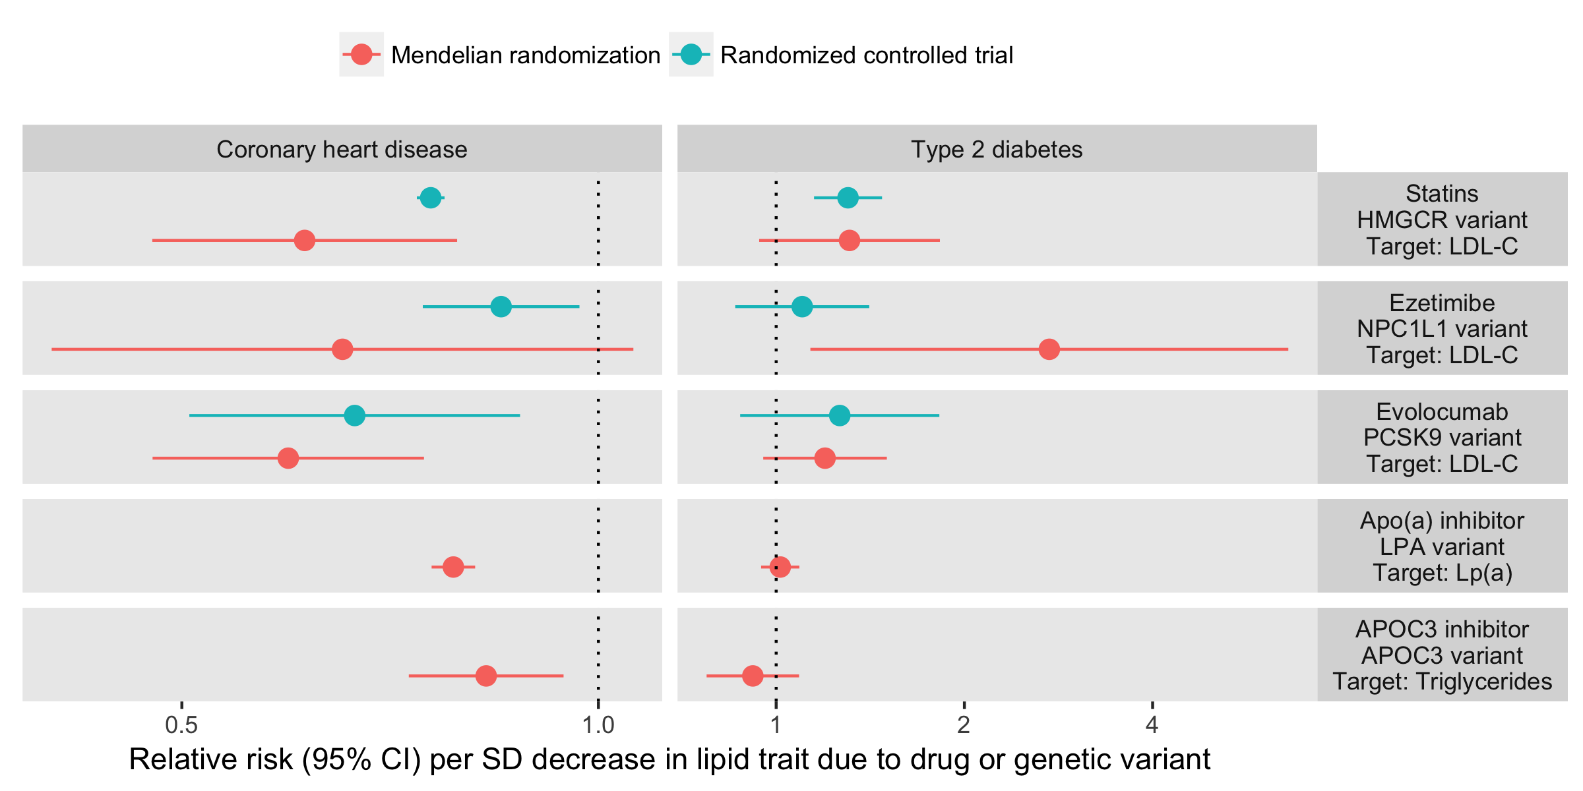
Predicting drug RCTs using MR

Slide 34
MR in practice

Slide 35
How to perform Mendelian randomization using only GWAS summary results

Slide 36
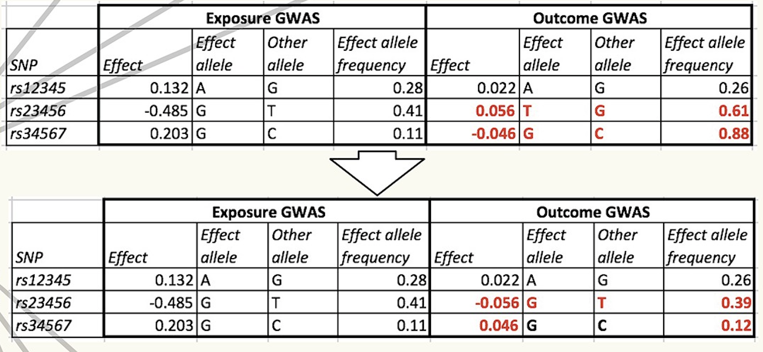
Harmonise exposure and outcome effects

Slide 37
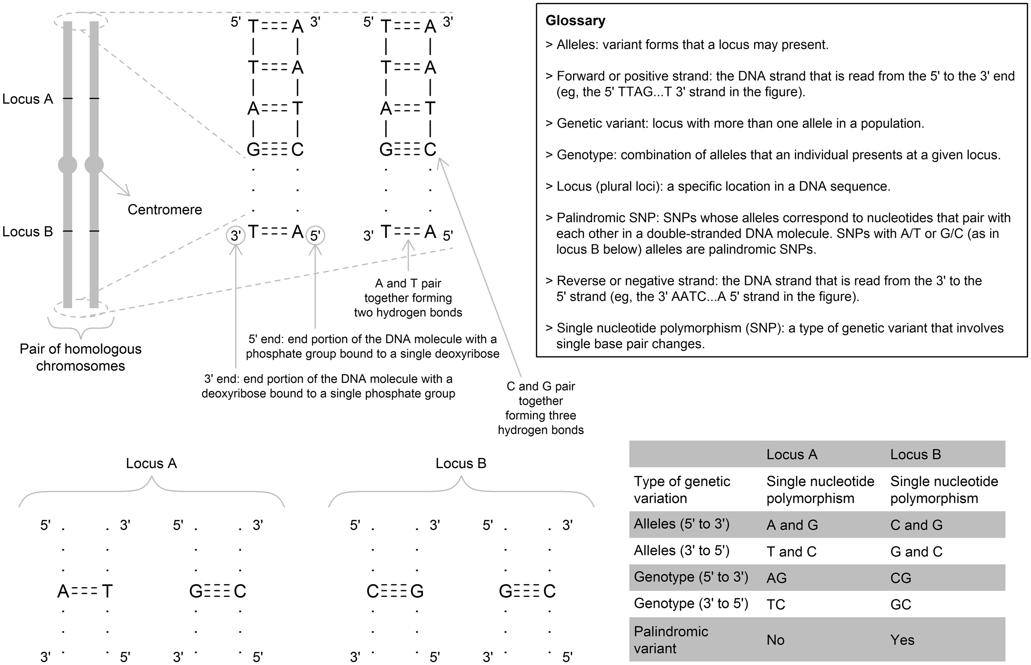
Hartwig et al 2017

Slide 38
Strand issue exercise
SNP | Study 1 alleles | Study 1 allele freq | Study 2 alleles | Study 2 allele freq | Verdict
rs1 | A/G | 0.2 | A/G | 0.2
rs2 | G/T | 0.3 | T/G | 0.72
rs3 | G/C | 0.65 | G/C | 0.62
rs4 | A/T | 0.49 | A/T | 0.50
rs5 | A/T | 0.12 | A/T | 0.89
rs6 | A/G | 0.4 | A/T | 0.4

Slide 39
Forest plot example for LDL cholesterol and CHD

Slide 40
Fixed effects meta analysis (aka inverse variance weighted, IVW)
There is one underlying ‘true’ effect
All deviations of sample effects from the ‘true’ effect are due to chance

Slide 41
Inverse variance weighted (IVW) fixed effects method
For N studies, each study i contributes more to the meta analysis if its standard error is lower

Slide 42
Calculate p-value
Look up or compute the associated p-value
P=0.05 → χ²=3.84
Z=1.96
P=0.001 → χ²=10.83
Z=3.29

Slide 43
IVW is equivalent to a weighted regression of SNP-exposure against SNP-outcome effects.
The weights are 1/se_outcome
The slope is the estimate of the causal effect
Confounders
SNP 1
SNP 2
LDL
CHD
SNP 3
SNP 4

Slide 44
Invalid instruments
Pleiotropy, reverse causation

Slide 45
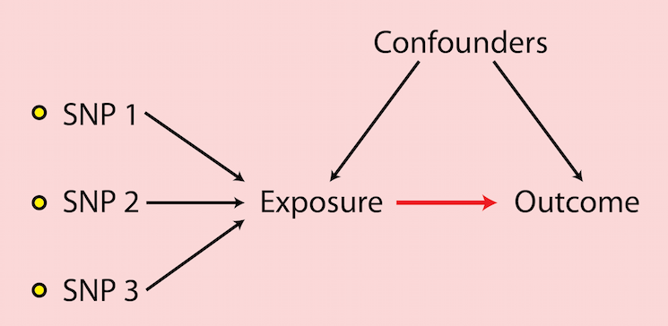
x
x

Slide 46
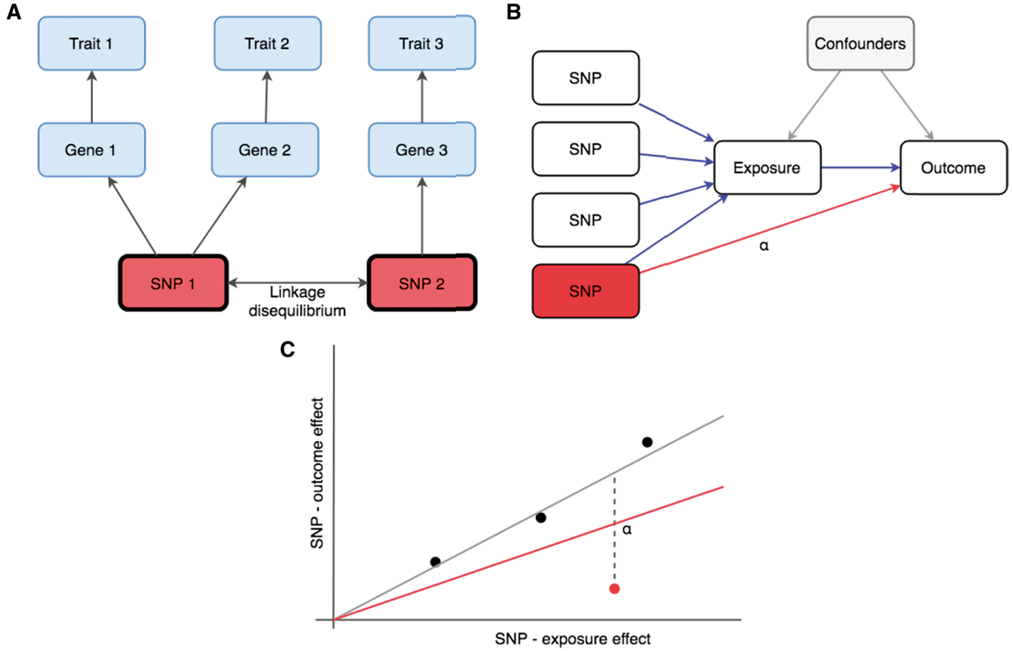
Pleiotropy
One genetic variant associates with multiple traits
Vertical pleiotropy
The variant influences one trait through another trait
This is the mechanism that enables MR
Horizontal pleiotropy
The variant influences two traits through independent pathways
This is a violation of MR assumptions (exclusion restriction principle)
Distinct causal variants
Two causal variants in LD, one influences trait 1, the other influences trait 2
Another means by which spurious MR results would arise
Notes:
Figure 1. (A) The same SNP can associate with multiple traits due to vertical pleiotropy, horizontal pleiotropy and linkage disequilibrium with distinct causal variants depending on the analytical context. To estimate the causal influence of gene expression level (Gene) 1 on Trait 1, SNP 1 is a valid instrument that acts in a vertical pleiotropic manner. But SNP 1 has a horizontal pleiotropic effect when using it to estimate the causal influence of Gene 1 on Trait 2. If SNP 1 was used to instrument Gene 1 to test its effect on Trait 3, it would exhibit a pleiotropic association through linkage disequilibrium with SNP 2. (B) A directed acyclic graph (DAG) in which four SNPs instrument an exposure. The fourth SNP has a horizontal pleiotropic effect of magnitude α. The impact of the horizontal pleiotropic effect is shown in the scatter plot in (C), where the grey slope represents the true causal effect obtained from the three valid instruments, and the red slope represents the IVW estimate when all SNPs are used as instruments.
46

Slide 47
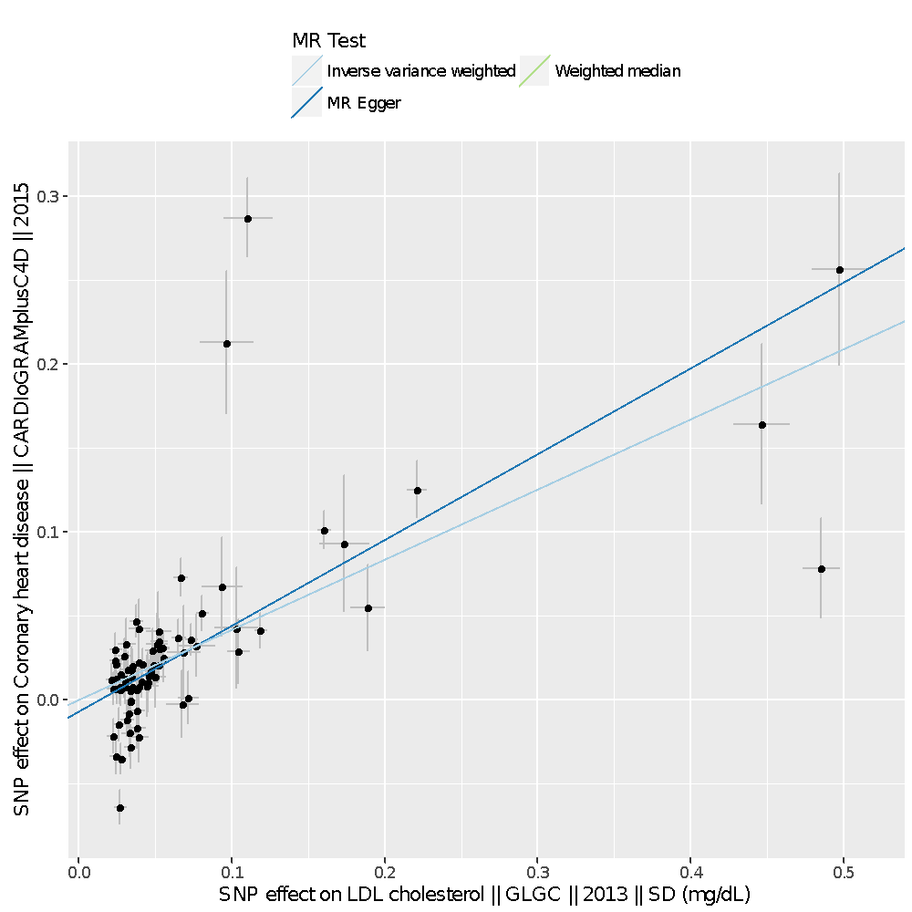
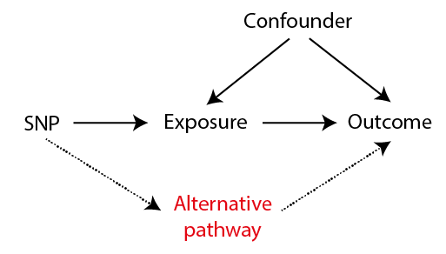

Slide 48
MR methods for handling horizontal pleiotropy
Many methods now exist

Slide 49
Heterogeneity
We expect that each SNP represents an independent study, and each should give an unbiased (if imprecise) estimate of the causal effect of x on y
Heterogeneity, where effect estimates are more different than expected due to standard errors, arises because at least some of the instruments are invalid
Cochran’s Q statistic
n=6 instruments
Expect Q = 5 if there is no heterogeneity
Q is chi-square distributed with n-1 degrees of freedom

Slide 50
Option 1: Remove outliers
Some SNPs might contribute to the majority of the heterogeneity
If we assume these are the invalid instruments then the IVW estimate excluding them should be less biased
However – beware of:
Cherry picking – remove outliers will artificially provide a more precise estimate
What if the outlier is the only valid instrument, and all the others are invalid?
E.g. cis-variants for gene expression, DNA methylation, protein levels. CRP levels are best instrumented by variants within the CRP gene region. Most other variants that come up in CRP GWAS are upstream effects related to inflammation

Slide 51
Option 2: Fit a model that is robust to some model of horizontal pleiotropy
IVW fixed effects estimate assumes all SNPs are valid instruments, and averages across them all
IVW random effects model allows all SNPs to be drawn from a different distribution – the estimate is the same but the standard error is larger if there is any heterogeneity
Several others…

Slide 52
Random effects
IVW
No horizontal pleiotropy

Slide 53
Option 3: Multivariable MR
We are testing for whether X1 has an influence on Y
We know that some instruments for X1 also have influences on X2
This opens up the possibility of horizontal pleiotropy biasing our estimate
What is the X1-Y association adjusting for X2?

Slide 54
Reverse causal instruments

Slide 55
Problem: MR of type 2 diabetes on BMI
GWAS of T2D reveals FTO variant
- Famously associated with BMI

Slide 57
Can we avoid including reverse-causal SNPs as instruments?
If A causes B and B causes C
The effect of A on B should be larger than the effect of A on C
Expect that
r²(SNP,B) = r²(SNP,A) x r²(SNP,B)
SNP
A
B
r²(SNP,A)
r²(A,B)
Steiger test used to evaluate if r²(SNP,A) > r²(SNP,B)
If this is not satisfied, infer that this instrument is not influencing the exposure primarily.

Slide 58
Single instrument analyses

Slide 59
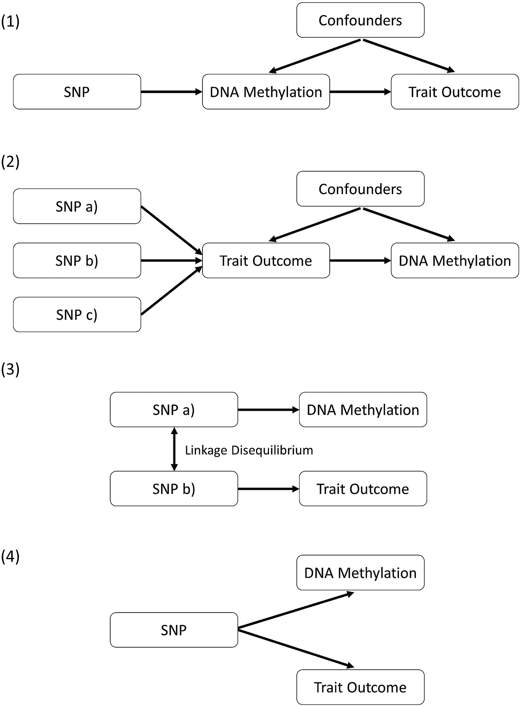
The single SNP scenario:
- Only 1 SNP known to influence the exposure
- SNP also associates with the outcome
How can this be interpreted?
Exposure causes outcome
Outcome causes the exposure
The exposure SNP is in LD with a SNP that influences the outcome (spurious pleiotropy)
The SNP confounds the exposure-outcome relationship (horizontal pleiotropy)
What can be done?
Richardson et al 2017 AJHG

Slide 60
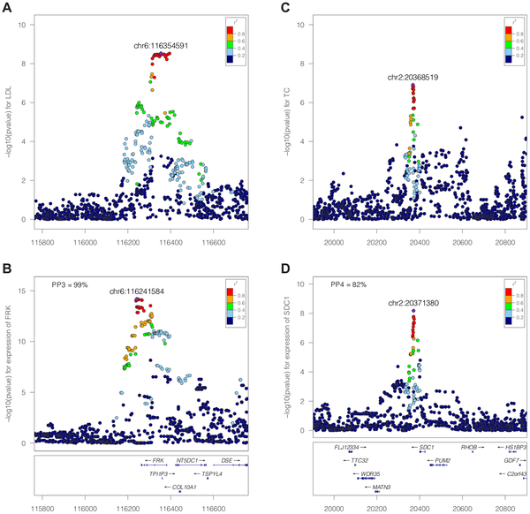
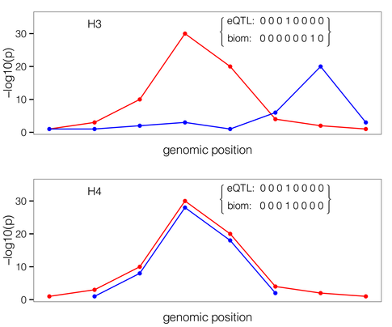
Eliminate possibility of spurious pleiotropy through genetic colocalisation
A,B
C,D

Slide 61
Summary
MR uses natural randomization to mimic an RCT
It is useful, data is abundant, but it is not a panacea for causal inference
Often valuable for proving that an hypothesised association is not causal
Crucial to perform sensitivity analyses and obtain metrics regarding the likely reliability of the MR estimates

Slide 62
Background reading
Epidemiology—is it time to call it a day? International Journal of Epidemiology, Volume 30, Issue 1, 1 February 2001, Pages 1–11
‘Mendelian randomization’: can genetic epidemiology contribute to understanding environmental determinants of disease? International Journal of Epidemiology, Volume 32, Issue 1, 1 February 2003, Pages 1–22
Mendelian randomization: genetic anchors for causal inference in epidemiological studies Human Molecular Genetics, Volume 23, Issue R1, 15 September 2014, Pages R89–R98
Evaluating the potential role of pleiotropy in Mendelian randomization studies Human Molecular Genetics, Volume 27, Issue R2, 1 August 2018, Pages R195–R208
Reading Mendelian randomisation studies: a guide, glossary, and checklist for clinicians BMJ 2018; 362
Orienting the causal relationship between imprecisely measured traits using GWAS summary data PLoS Genet 2017 13(11): e1007081
Mendelian randomization in cardiometabolic disease: challenges in evaluating causality. Nat Rev Cardiol. 2017 Oct;14(10):577-590
Using genetic data to strengthen causal inference in observational research Nature Reviews Genetics volume 19, pages566–580 (2018)
Detecting individual and global horizontal pleiotropy in Mendelian randomization: a job for the humble heterogeneity statistic? American Journal of Epidemiology 2018, kwy185
The MR-Base platform supports systematic causal inference across the human phenome eLife 2018;7:e34408
Mendelian randomization accounting for horizontal and correlated pleiotropic effects using genome-wide summary statistics. https://www.biorxiv.org/content/10.1101/682237v1
Simultaneous estimation of bi-directional causal effects and heritable confounding from GWAS summary statistics. https://www.medrxiv.org/content/10.1101/2020.01.27.20018929v1

